Slide 1
APC system update project
By Ethan Dunzer

Slide 2

APC ?
Appalachia Publishing Collective (APC)

Slide 3
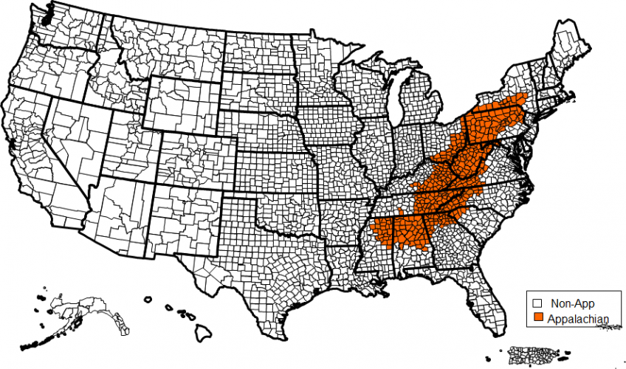

Slide 4
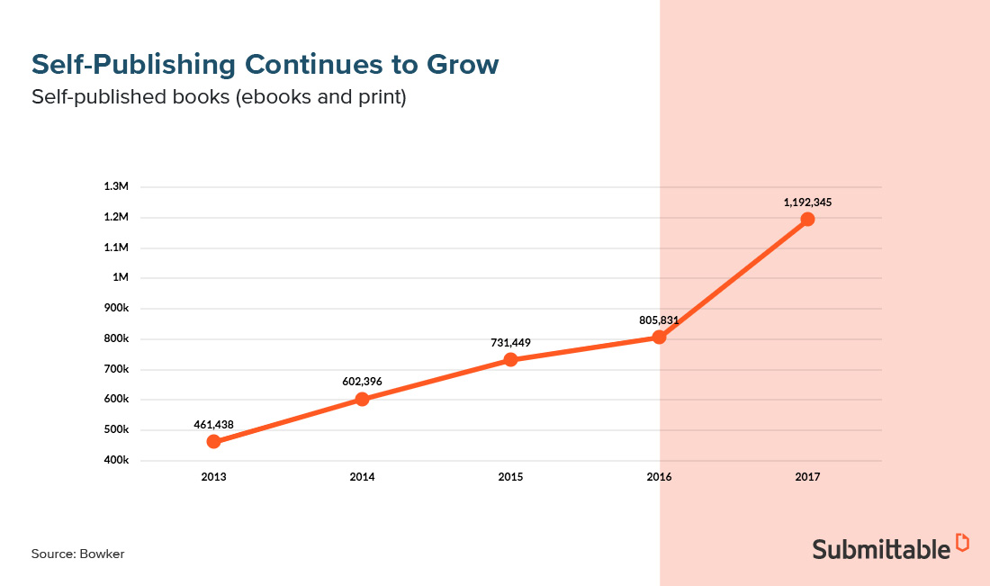

Slide 5
What is my role ?
Systems design consultant for APC

Slide 6
Project overview

Slide 7

What is the project ?
Business system redesign
Addition of new technology
New business processes
New workflow process

Slide 8

What does the project detail ?
Submit manuscripts electronically.
Track manuscripts progress through review process.
Categorize manuscript by genre, subject, and publication type (print or eBook).
Pre publish book ISBN assignment.
Distribution of published books.
Sales from published books.

Slide 9
Why is this needed ?
APC needs to expand and capitalize
The goal of APC to increase their business growth by 85% over the next 3 years.

Slide 10
Project challenges

Slide 11
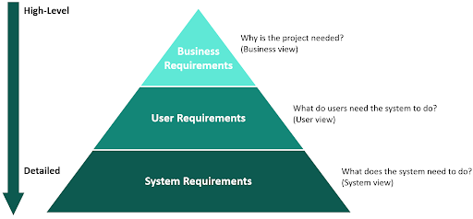
What Objectives are needed ?

Slide 12

Will the system function with the users ?
Every user is different.
Use cases can change.
Unforeseen functions may need to be added.

Slide 13

Reflection

Slide 14


What did I learn ?
Writing to a particular audience.
Technical writing formatting.

Slide 15

What would I do it differently ?
Give more setup to the project idea.
Create multiple documents for different audiences.
Provide more audience identification when writing.

